Slide 1

Filtering’s Practical Application to Pixel-Art
A study of Filtering’s uses within Pixel-Art Designs, it’s challenegs and successes, as well as how to properly design Filters for use upon the Pixel-Level of images
By Dylan Gartin – 4/21/2022
Notes:
clear problem definition and argumentation of why this problem is important, an overview of related work,
detailed explanation of the approach, well-motivated experimental evaluation, including setup description.

Slide 2

Overview
Introduction To Pixel-Art and Image Filters
Can Filtering be used on Pixel-art? (Well Yes, but Actually No)
Problems With Pixel-art using Filters
What Filters Work With Pixel-Art
How To Filter Pixel-art
My Code Examples
Examples of Pixel Art Used To It’s Filtering Finest

Slide 3
Introduction To Pixel-Art
“Pixel-art … is a form of digital art, drawn with software, whereby images are built with the exclusive and intentional placement of pixels.” – Wikipedia
While the overall definition of pixel art is up for debate, the general consensuses that pixel-art is where each and every pixel placed onto the screen has a purpose for the placement and once can tell what that purpose is by looking at the image as a whole.
Was originally invented when computers had to low of resolution to be able to generate higher quality graphics, as a method
While no longer required is still heavily used in both art and media to this day
Most common uses is in the indie game development (Smaller Game Companys)

Slide 4
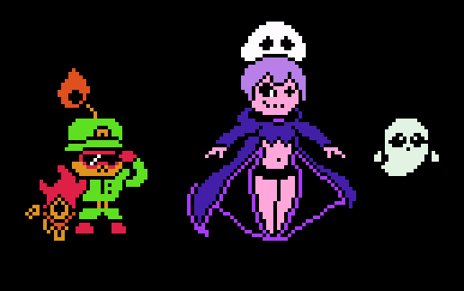
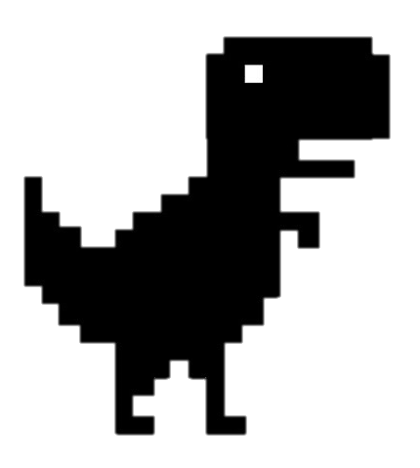

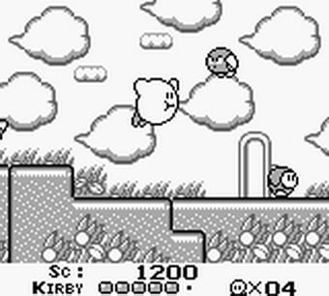
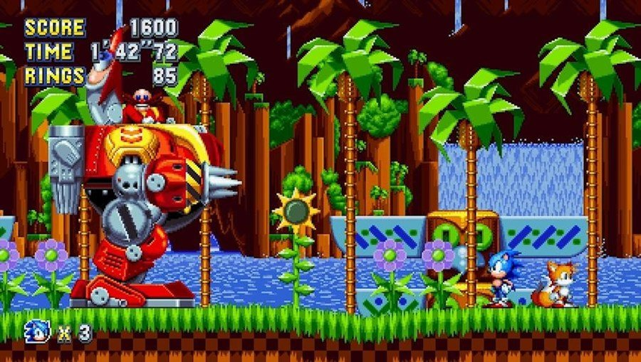
Pixel Art Examples
Google’s Error Dino
Assorted Characters(Myself)
Wizard Portrait Example (Wikipedia)
And Many, Many, More!!!
Kirby’s Dreamland (Nintendo)
Sonic Mania (Sega)

Slide 5
Introduction To Image Filters
Image Filters, In terms of this Study – “The process of filtering is also known as convolving a mask with an image. As this process is same of convolution so filter masks are also known as convolution masks” – (Lecture Notes Computer Vision)
In more simplistic terms, it is a way of adjusting an image that can use an algorithm based code or procedure in order to produce a certain effect.
What effect the filter has depends on the goal of the filters, it could change colors, apply outlines, blur images, or entirely different effects.

Slide 6
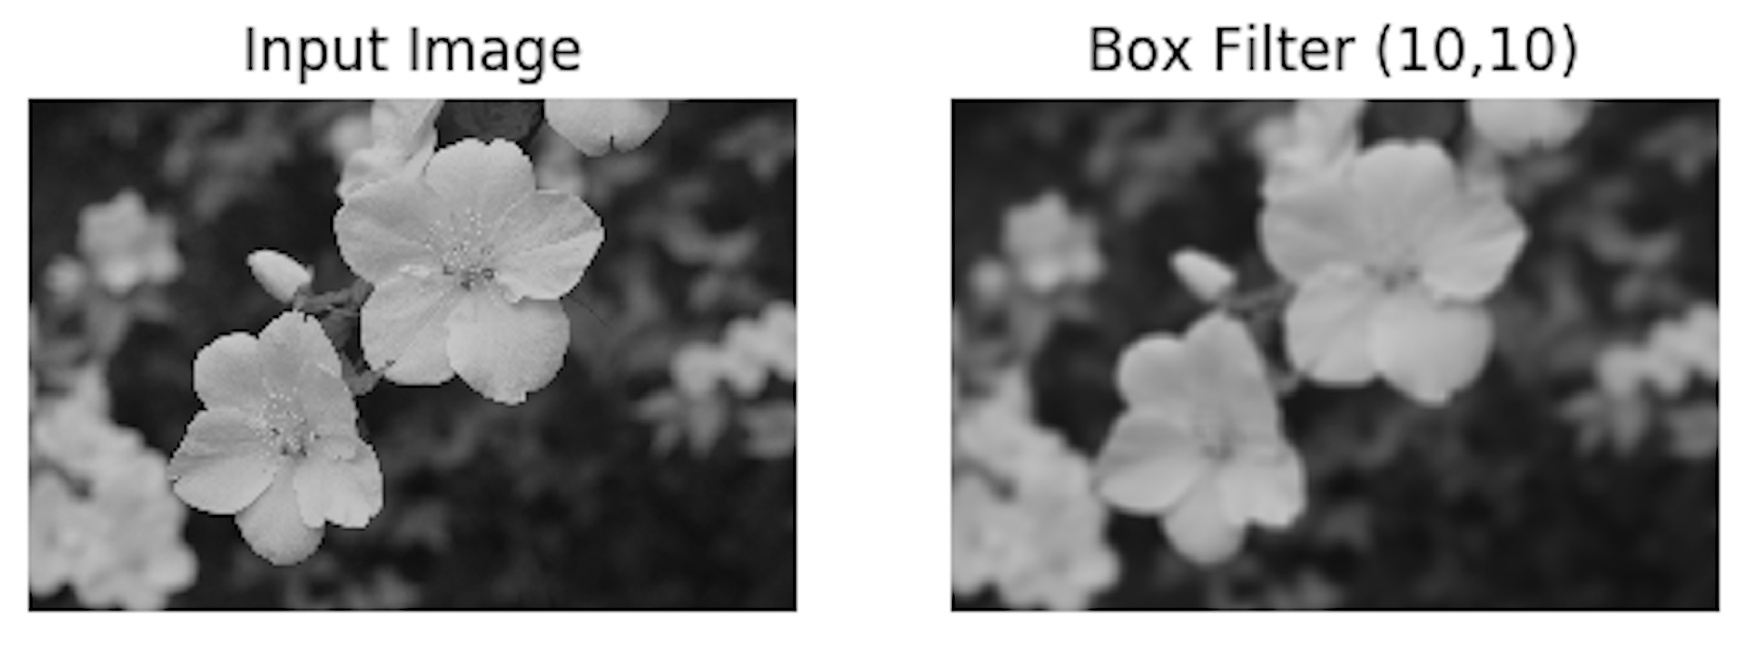
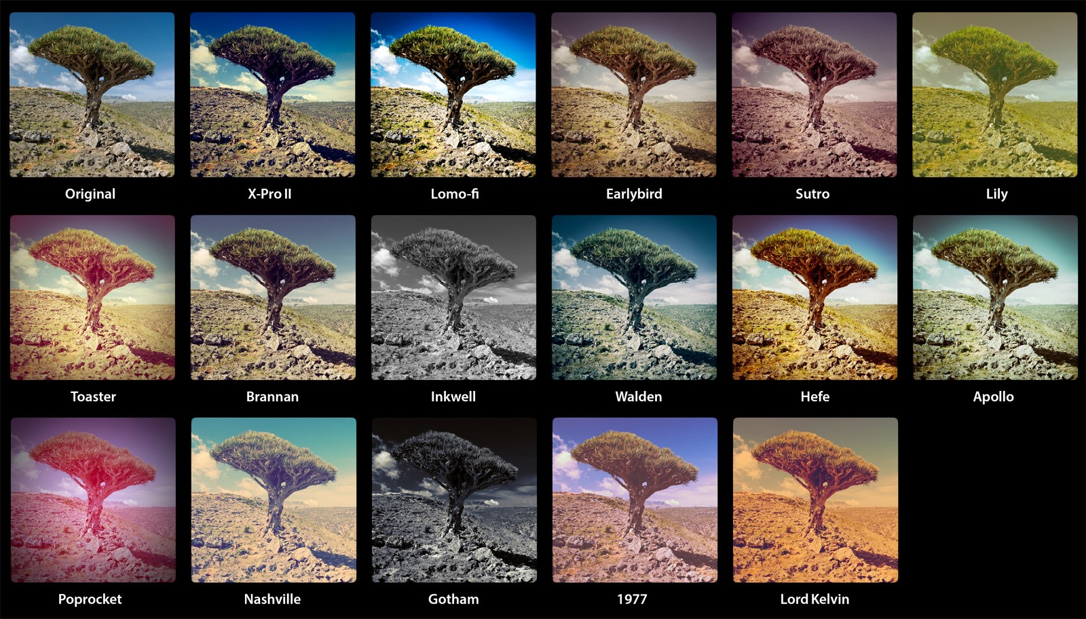
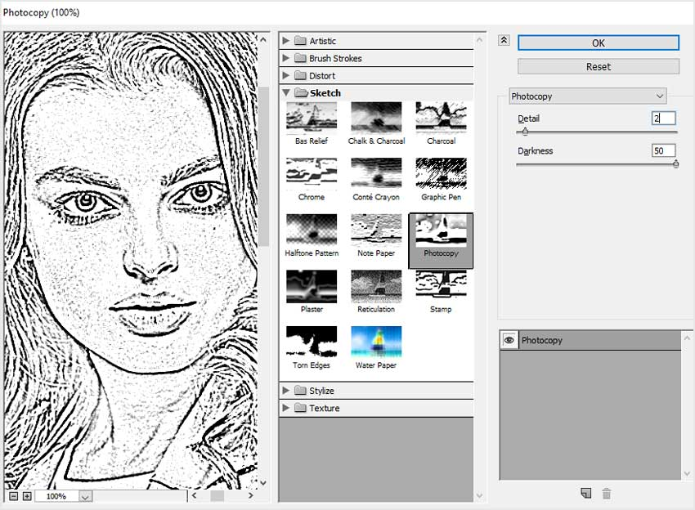
Image Filters Examples
Box Filter Using OpenCV
Assorted Color Filter Effects – Java servlet Filters
Line Art Filtering - Photoshop

Slide 7
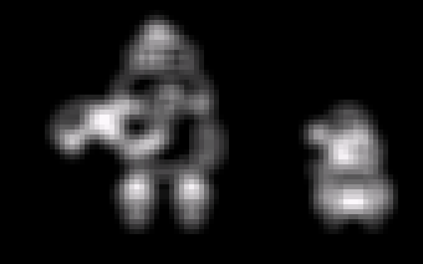
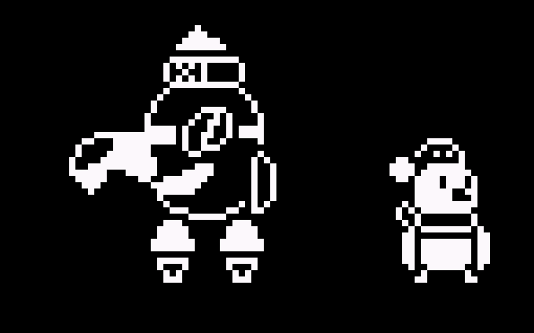
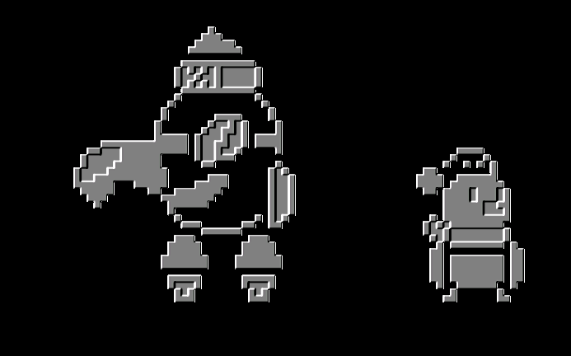
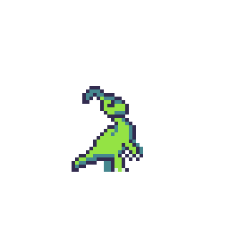
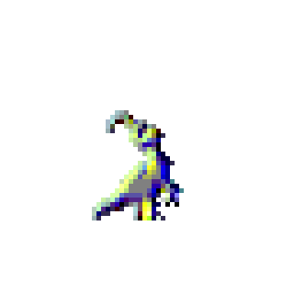
So, Can Filters Be Used On Pixel Art?
U Gud?
Well, in the technical sense yes, but in a practical sense no.
It greatly depends on the type of filter and type of pixel art given
Nah Bro.
Notes:
The Problem

Slide 8

The Problems With Pixel-art using Filters
Most Forms of filtering are far to strong on Pixel-art, causing terrible blurring, or very overdramatic effects that are impractical for actual Use
This is typically due to the small sizes of the pixel art itself, Of which most filters are not designed to work with
Limited color pallets make it where drastic changes on colors have more prominent effects.
Simply put, in this day and age the larger pixel sizes of images is taken into account for images. As such pixel art sizes do not match up with other images scales
As such, out of the box a majority of filters simply are incompatible with modern technology’s filtering

Slide 9
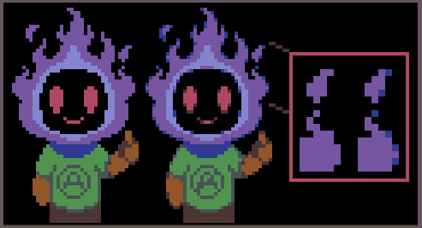
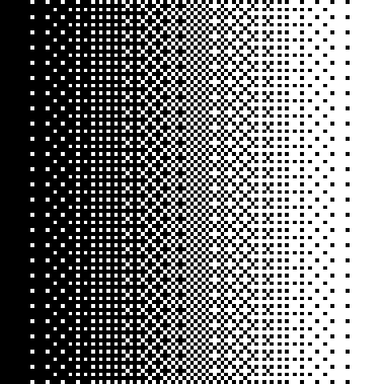
What Filters Work With Pixel-Art
Color Filters Are one of the most effective types of filters you can use with pixel art
As changing colors does not adjust positions or usually cause blurring, these types of filters can work right out of the box usually.
Non-Filtering Methods of Adjustments
By instead editing the animations or artwork themselves to apply the sort of “filter” effect directly in a way an algorithm would be unable to do as of this
Ex. Manual Anti-aliasling and Dithering
Increase the size of the pixel-art to lessen the filters effects.
Or simply no filtering at all.

Slide 10
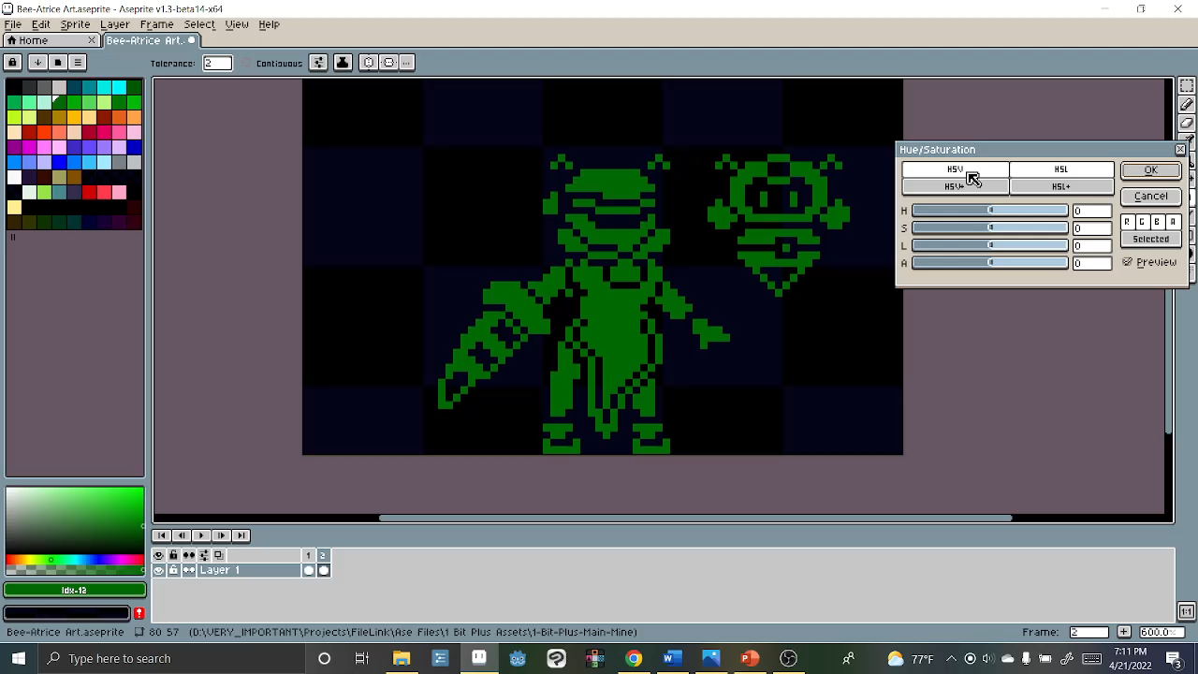

Slide 11
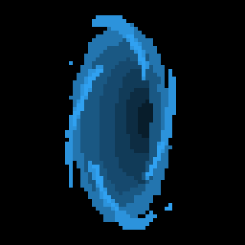
How To Filter Pixel-art
So now that we know why most types filters aren’t used in pixel-art is there a way to fix this?
Actually yes, there are two ways, each with their own advantages and drawbacks
Since they are simply not built with each other in mind we simply have to adjust one or the other to fit themselves
Make The Pixel-art Fit the Filters
Make the Filters fit the Pixel-art

Slide 12
Making the Filter Fit– My Takes
When it Comes to making Filters fit the Pixel art I came up with three different ideas
Reduction of the Algorithm we have been studying in class, the convolution matrix's, from 3 by 3 to 2 by 2.
Pseudo Design of Filter Effects, Without Using any Code.
Design of Filters based Around the pixel art specifically.

Slide 13
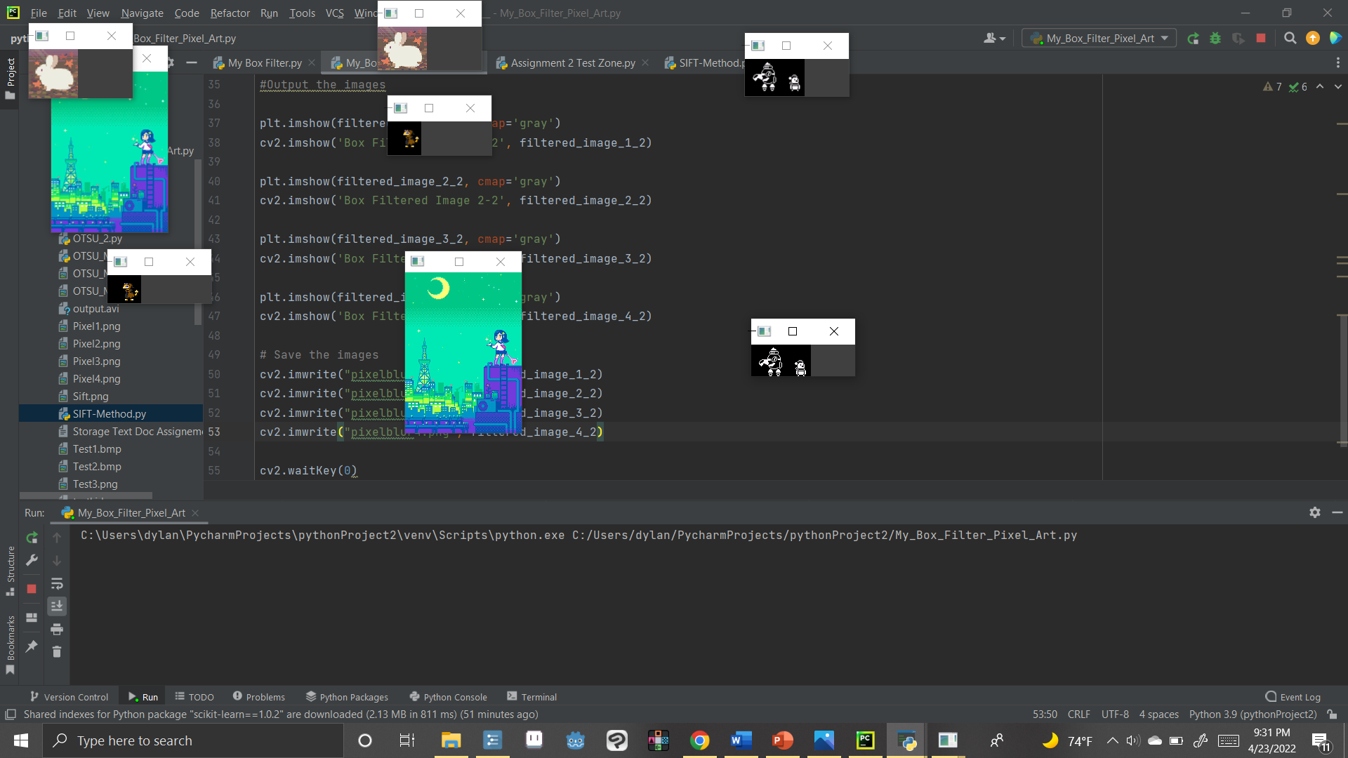
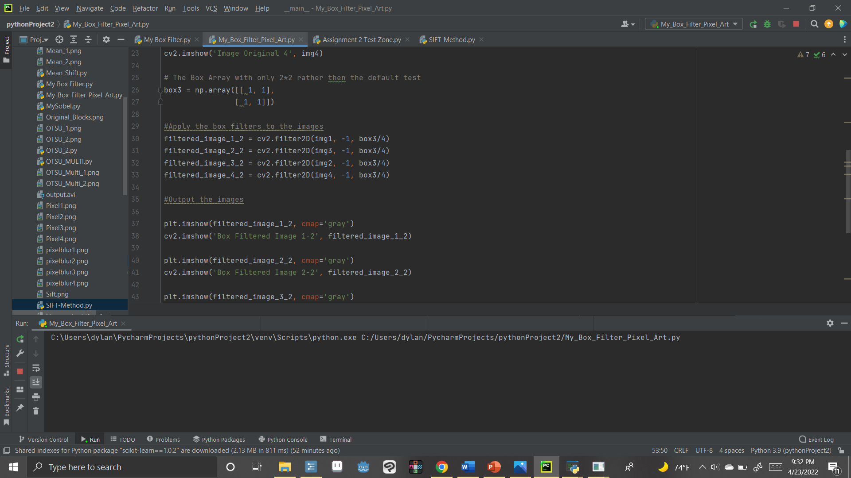
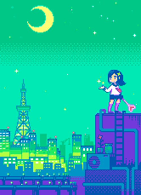
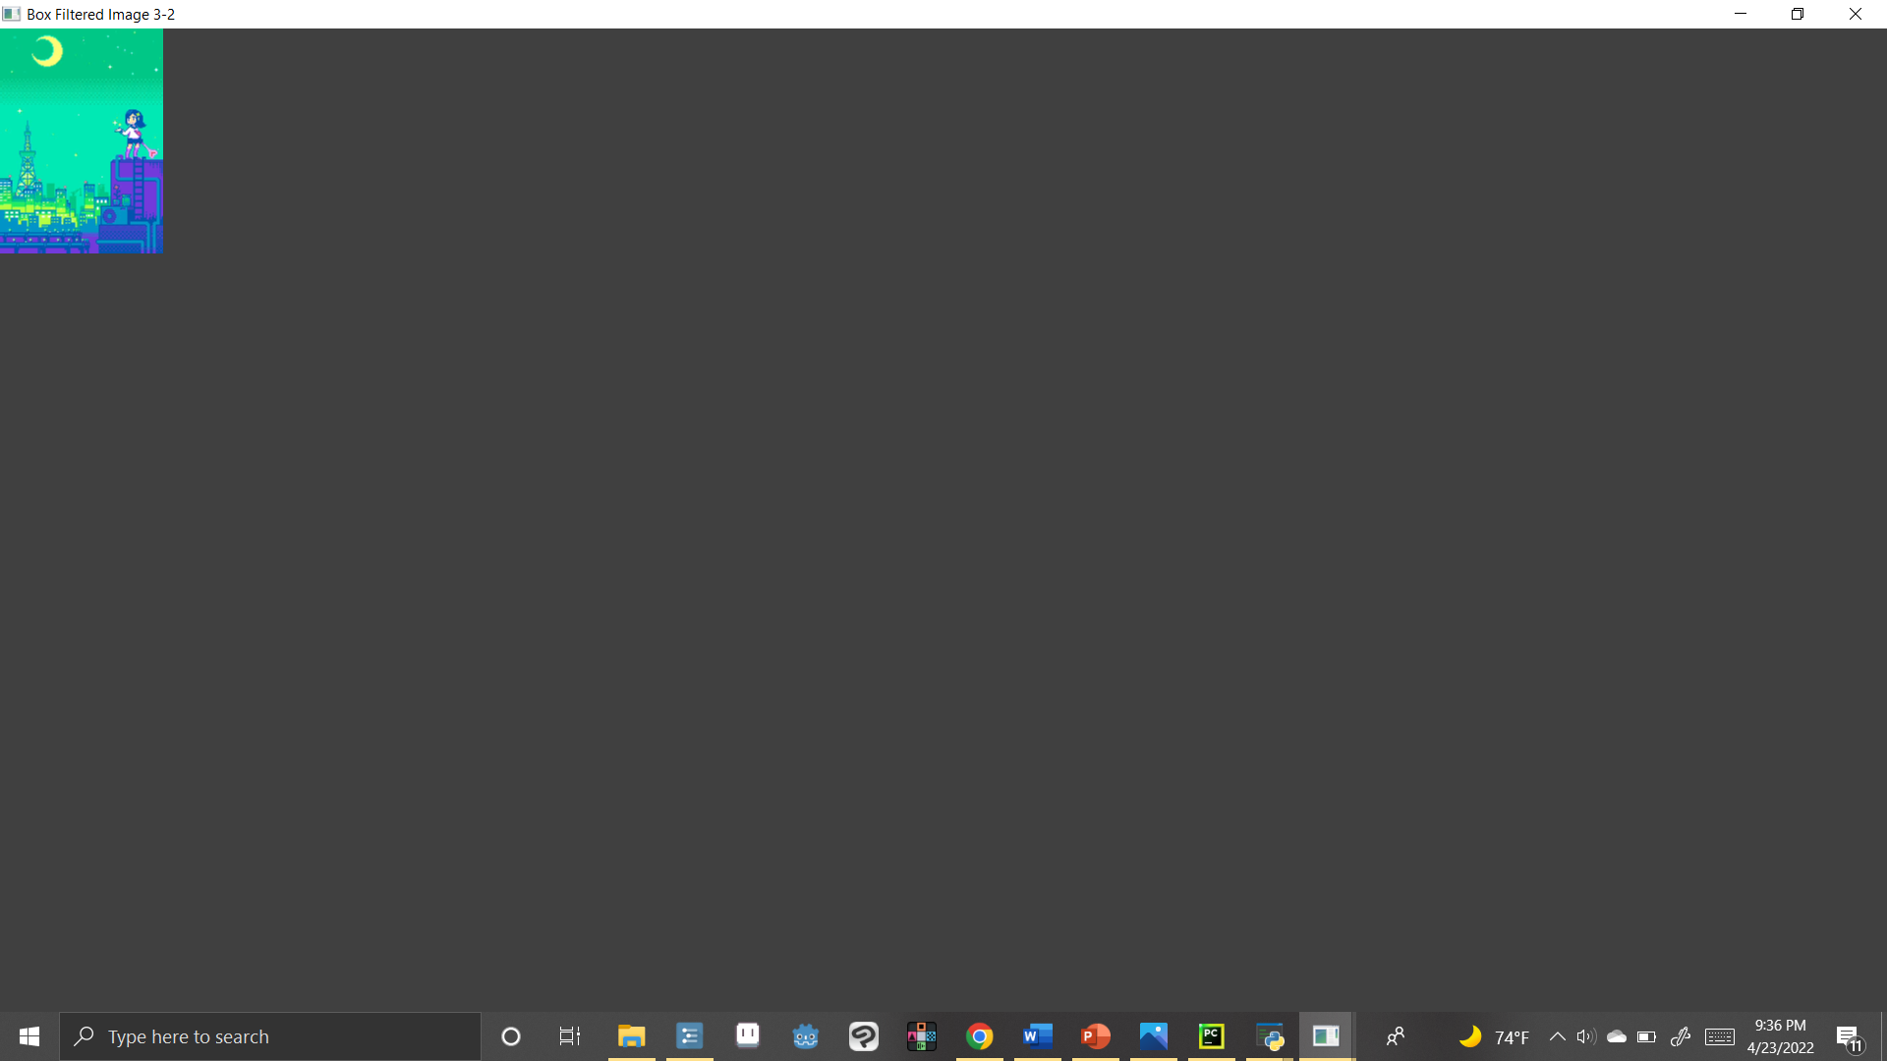
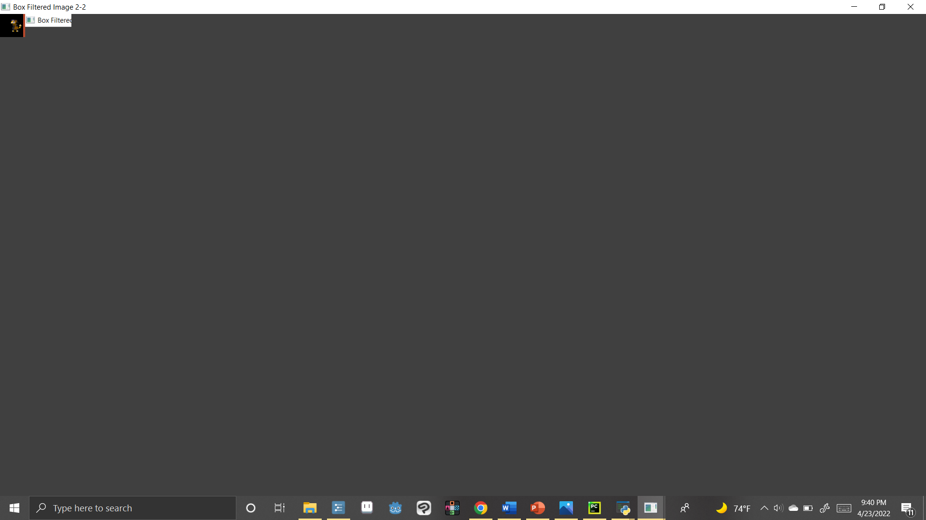

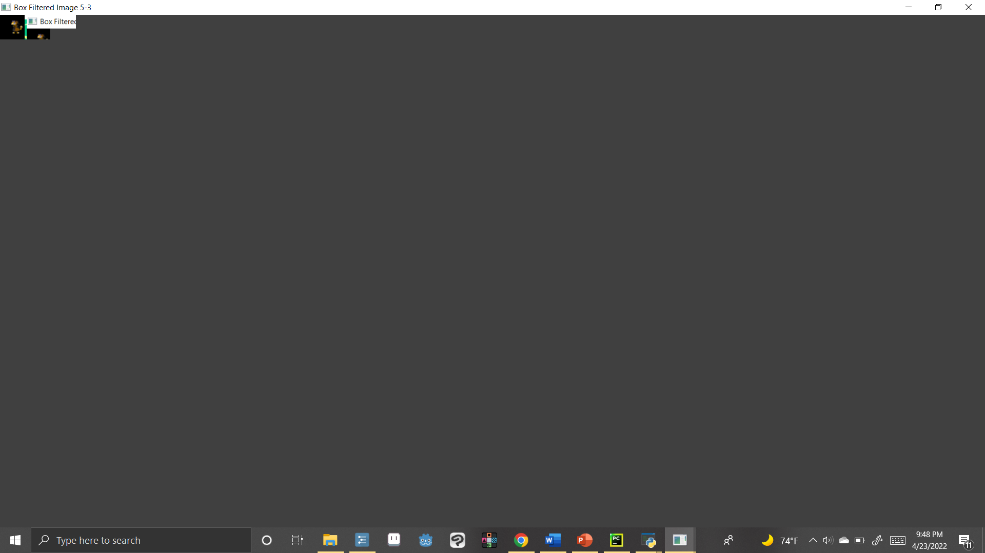
2*2 Filter Test
This is a test of using the convolution matrix at a 2 by 2 size rather then the typical 3 by 3 size
Results are a bit hard to tell on small scale, however when blown up the results were actually unexpectedly effective in blurring some of the larger ones.
On Portraits seems to be effective, n sprites not so much, however it is an improvement at least compared to 3*3

Slide 14
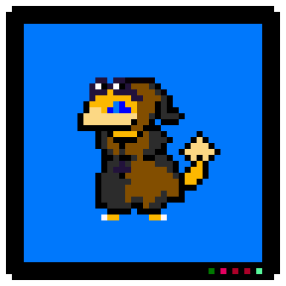
Pseudo-Filter – Glitch Design
The Following is not a Filter, but it applies the same principals as an actual filter.
With more time could build a code algorithm to mimic this effect process.
The following is a glitch effect, done entirely with Aseprite itself by using manual animalization.
Planned on also making a code version of this one but didn’t get that far.
Example Pseudocode for this –
For (each row I in the sprite)
{
For(1 = Random.(1-10) ) {#ten pecent chance
Displace pixels in row by random.(1-3 pixel).+x
#move pixels by 1 to 3 pixels
}
For(1 = Random.(1-10) ) {#ten percent chance
Displace pixels in row by random.(1-3 pixel).-x
#move pixels by 1 to 3 pixels left
}
}
Notes:
The exact processs the effect uses is

Slide 15
Godot Shaders As Filters
Game engines have been able dealing with this problem for awhile now.
Within Godot Filters are designed via Shaders which allow you to use them on images of any sizes with rather efficiently on any form of objects, sprites included.
The only issue is it uses a completely different code language from godot
Using template project, item I designed my own flash filter as seen here, along with a few other versions of it
How shaders work:
Design and code the pramaters into variables
Adjust these variables paramaters then when an action in game occurs that you want as the trigger
#Shader Filter – Pixel art Flash Effect
shader_type canvas_item;
uniform vec4 flash_color: hint_color = vec4(1.0);
uniform float flash_modifier: hint_range(0.0, 1.0) = 1;
void fragment(){
vec4 color = texture(TEXTURE, UV);
color.rgb = mix(color.rgb, flash_color.rgb, flash_modifier);
COLOR = color;
}
# Godot Code to apply the shader on flash hit
sprite.material.set_shader_param("flash_modifier",0.5)

Slide 16
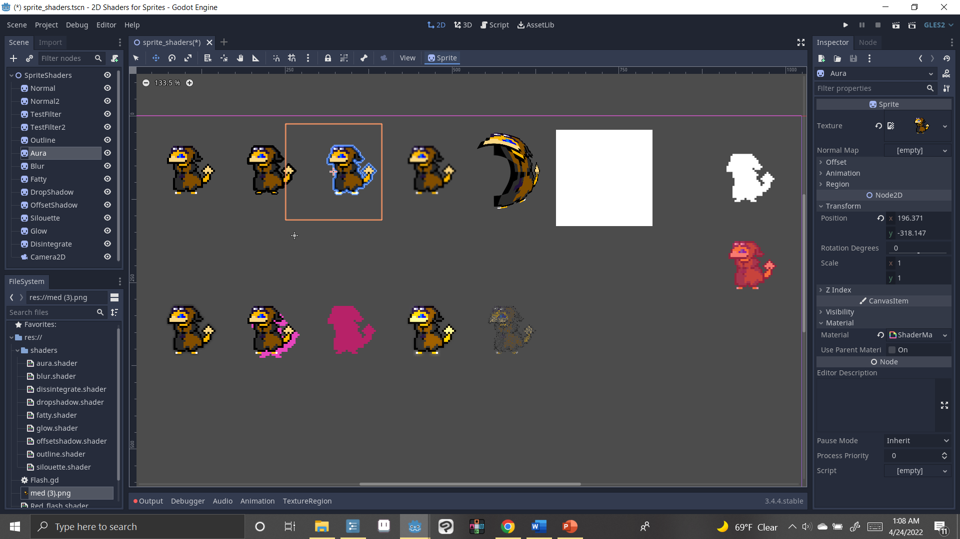
Godot Shaders As Filters

Slide 17
Look at Example Codes From Godot
#backdrop Silloette code
shader_type canvas_item;
render_mode blend_mix;
uniform vec2 offset = vec2(8.0, 8.0);
uniform vec4 modulate : hint_color;
void fragment() {
vec2 ps = TEXTURE_PIXEL_SIZE;
vec4 shadow = vec4(modulate.rgb, texture(TEXTURE, UV - offset * ps).a * modulate.a);
vec4 col = texture(TEXTURE, UV);
COLOR = mix(shadow, col, col.a);
}
#Shader outline
shader_type canvas_item;
render_mode blend_mix;
uniform vec4 modulate: hint_color;
void fragment() {
COLOR = vec4(modulate.rgb, texture(TEXTURE, UV).a * modulate.a);
}
Overall, this has been rather complicated as code wise this has been essentially me trying to learn my code language. It’s very intriguing and if an plan on looking into it more so for effects complex art wise.

Slide 18
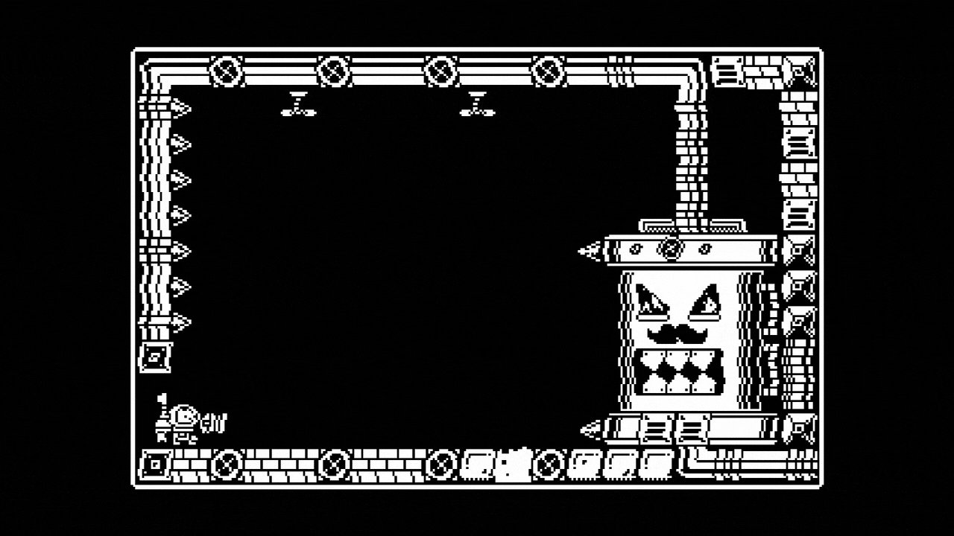
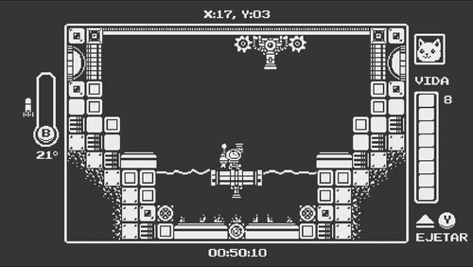
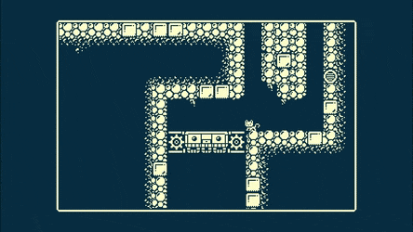
Examples of Pixel Art Used To It’s Filtering Finest
When it comes to prominent games that have used Filtering with Pixel Art in Recent times the most recent mainline example that can be found is “Gato Roboto” A Pixel-art Metroid-vania (A style of game in which challenges are overcome by collection of things, such as new powers and information), who uses various types of filters in order to produce interesting effects.
Notes:
The main filtering examples is in the cosmetic charges your able to find as bonus collectable which change the color of the game,

Slide 19
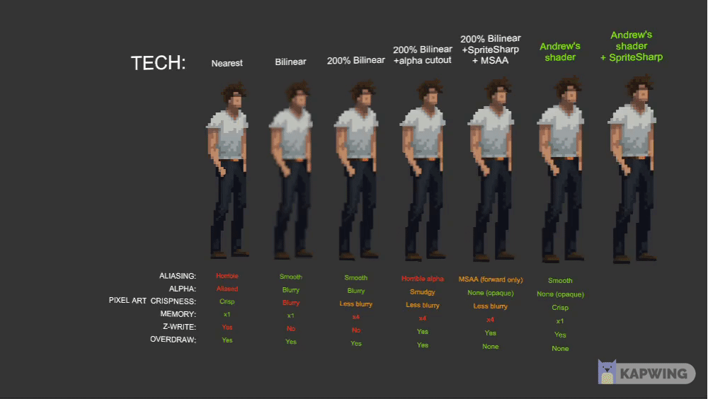
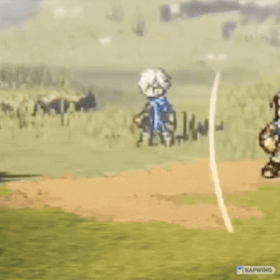
Making the Filter Fit the Art – Examples
Another Interesting Example, showcased by Tim Soret is a actually with filtering you can apply rotational effects and motions to pixel art directly without having a jitter effect. This rather recently came into invention in 2018 with “Octopath Traveler” wanted to apply non-jittering effects to they’re characters sprites in combat.

Slide 20
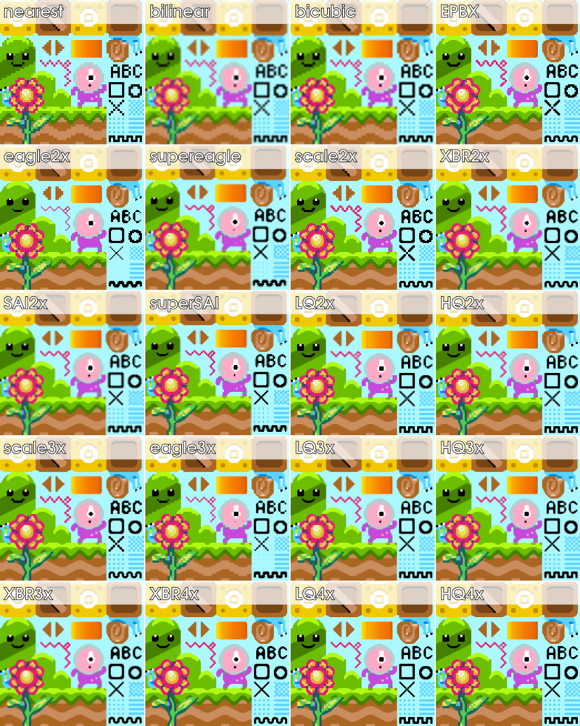
Other uses of filters in pixel art
A last bit of info I found about image filtering was how base filtering algorithms can be used to change how filters render various properties of the pixels Base Rendering.
Overall, the base types of rendering each have there own forms of advantages and disadvantages as can be seen by the example
Notes:
The exact processs the effect uses is

Slide 21
Conclusion
Overall, filters are not built with pixel-art in mind out of the box.
This is due to pixel art limitations in things such as sizes and pallets
It is however possible to engineer filters or pixel-art to work with the other one to varying degrees of success
While often not used much with pixel art, filtering can both improve visuals appeal and fix glitches with rendering in your artwork

Slide 22
References
Found within the Report

Slide 23
Thank You For Your tIME!
Any Questions?
Notes:
clear problem definition and argumentation of why this problem is important, an overview of related work,
detailed explanation of the approach, well-motivated experimental evaluation, including setup description.

